Slide 1

Assignment Marks: 10
Marking Criteria
        Referencing
        Coherence, consistency and argument
        Creativity

Slide 2
Any Topic below
      History and Origin of Civilization
      Development of Civilization
      Importance of studying the history of civilization
      Mesopotamian Civilization
      Egyptian Civilization
      Indus Valley Civilization
      Greek Civilization
      Roman Civilization
      Chinese Civilization

Slide 3
    Civilization in the Muslim Middle East
    Slavery and Feudalism in Europe
    Medieval Education: Growth of Universities
    Religious Crusades and modernity
    The Renaissance in Europe
    Scientific Revolution
    Enlightenment
    French Revolution
    Industrial and Post Industrial Revolution
    The clash of civilization

Slide 4
  Guidelines for Presenting Assignment
  Title page
  Abstract: not more than 150 words
  Acknowledgement
  Table of contents
  Lists of tables, figures, etc (optional)
  Main text (ensure in-text citation)
  References: You must be consistent with the reference style.

Slide 5
Format
Word Length: At least 1000 words
      Page Size: A4
      Font Style: Times New Roman
      Line space:1.5
      Deadline of submission: January 07, 2024
      Please make sure that the work is not plagiarized at all.

Slide 6
Title
In selecting the title, the following points should be taken care of:
Reflect the theme of the research
Be self-explanatory
Be brief
Language be simple and unambiguous
Be specific to a particular domain
Avoid confusing meaning

Slide 7
Introduction
What specific need or problem does your assignment address?
How was the need identified and its significance?
Who will benefit from the assignment?
What are the objectives of the assignment?

Slide 8
Objective: Broad and Specific
The objective should be stated very clearly
The objective stated should be specific, achievable and measurable
Too many objectives to be avoided
Specific objectives should be presented in the appropriate order of importance

Slide 9
Methodology !

Slide 10

Academic honesty & dishonesty
Academic honesty refers to the principle that a student's work is original and authentic and completed according to university rules.
Academic dishonesty is any type of cheating that occurs in relation to a formal academic exercise.

Slide 11
Academic honesty & dishonesty
Academic honesty refers to the principle that a student's work is original and authentic and completed according to university rules.
Academic dishonesty is any type of cheating that occurs in relation to a formal academic exercise.

Slide 12

Types of Academic Dishonesty
Cheating: Using or attempting to use unauthorized materials, information & study aids in any academic exercise.
Fabrication: Falsification or invention of any information or citation in an academic exercise.
Facilitating academic dishonesty: Intentionally or knowingly helping or attempting to help another to commit an act of academic dishonesty.
Plagiarism

Slide 13
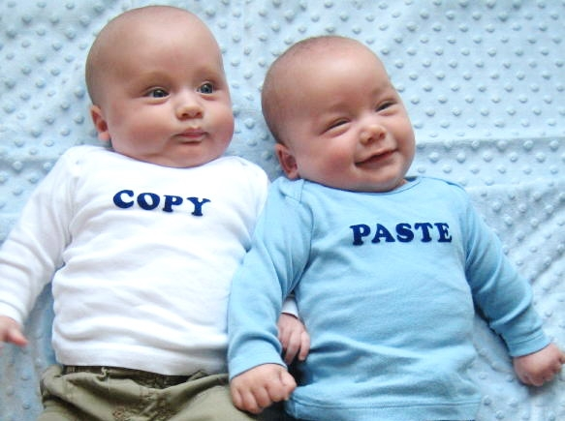

What is Plagiarism?
The act of stealing someone else's work and attempting to "pass it off" as your own. We define plagiarism as any of the followings:
the inclusion of paragraphs, sentences or even phrases quoted directly from other authors without acknowledgement by appropriate references.
the unacknowledgement paraphrasing of the work of other authors.
copying another student’s work and pretending it is your own.
downloading a writing from the Internet and pretending
it is your own.
helping or colluding with others to cheat.

Slide 14
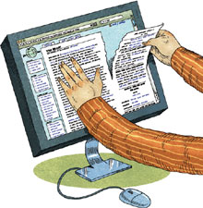

Intentional vs Unintentional Plagiarism
Copying a friend’s work
Buying or borrowing reports
Cutting and pasting text from sources without giving credit
Using minimal or careless paraphrasing
Failing to document or “cite” properly
Quoting excessively

Slide 15


Types of Plagiarism: Copying
The most well-known and, sadly, the most common type of plagiarism is the simplest: copying. If you copy someone else's work and put your name on it, you have plagiarized.

Slide 16


Types: Paraphrasing Plagiarism
The third type of plagiarism is called paraphrasing plagiarism. This occurs when the plagiarizer paraphrases or summarizes another's work without citing the source. Even changing the words a little or using synonyms but retaining the author's essential thoughts, sentence structure, and/or style without citing the source is still considered plagiarism.

Slide 17

Paraphrasing: An Example
Children are completely insensitive to their parents' shyness and rarely label their parents as shy. Because the parents are the authority and controlling figures in the home, they may not feel shy and therefore not show their shy side.

Slide 18

Why do people plagiarize?
Excuses:
It’s okay if
I don’t get caught!
Everyone does it!
Report/monograph writing
is BORING!
I cannot understand
my supervisor
I’ve got to get
into
??? U.!
It saves a lot
of time!
My parents
expect “A”s!

Slide 19



Poor understanding of the nature of plagiarism
confusion
‘cultural’ factors

Slide 20


Question
Why should we be concerned about it?

Slide 21
Because…
If you plagiarize, you are cheating yourself.
  You don’t learn to write out your thoughts in your own words, and you don’t get specific feedback geared to your individual needs and skills.
  Plagiarizing a paper is like sending a friend to basketball practice for you – you’ll never get the benefit of the practice yourself.
Plagiarism is dishonest because it misrepresents the work of another as your own.
Plagiarism devalues others' original work.
  Submitting another writer's work as yours is taking an unfair advantage over students who do their own work.

Slide 22


Legal Implications
It is against the law.
All universities have strict policies on cheating and plagiarism.
  Suspension
  Cancelation of the running exams.

Slide 23

What happens to a plagiarist?

Slide 24


Do I have
to cite
everything?
NOPE!!!!
Facts that are widely known, or Information or judgments considered “common knowledge”. .
Hooray for
common
knowledge!

Slide 25
Examples of common knowledge
*Donald Trump was the president of the USA. *Bangladesh became independent in 1971.
But when in doubt, cite!
No need to document:
You are discussing your own experiences, observations or reactions.
Compiling the results of original research.
You are using common knowledge

Slide 26



How to Avoid Plagiarism?
Avoiding plagiarism is quite simple. The best method for avoiding it is to simply be honest; when you've used a source in your paper, give credit where it's due. Acknowledge the author of the original work you've used.

Slide 27

How to Avoid Plagiarism
Quoting
Paraphrasing
Summarizing
To blend source materials with your own, making sure your own voice is heard.

Slide 28
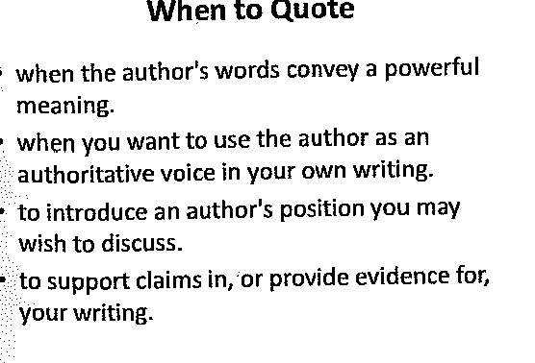
Quoting
Quotations are the exact words of an author, copied directly from a source, word for word. Quotations must be cited! For example, Zimbardo (1977) notes that “Children are totally insensitive to their parents’ shyness” (p. 62).

Slide 29
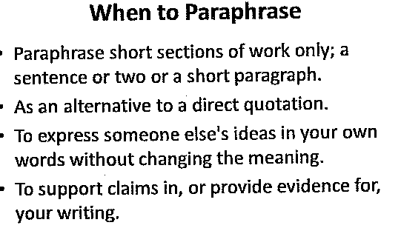
Paraphrasing
Paraphrasing means rephrasing the words of an author, putting his/her thoughts in your own words. When you paraphrase, you rework the source’s ideas, words, phrases, and sentence structures with your own. Like quotations, paraphrased material must be followed with in-text documentation and cited on your Works-Cited page.

Slide 30
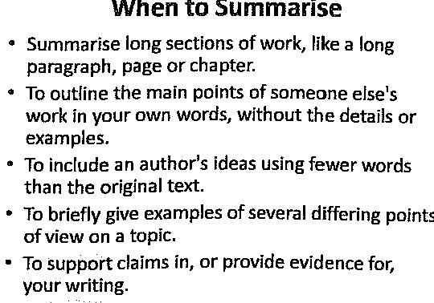
Summarizing
Summarizing involves putting the main idea(s) of one or several writers into your own words, including only the main point(s). Summaries are significantly shorter than the original and take a broad overview of the source material. Again, it is necessary to attribute summarized ideas to their original sources.

Slide 31
Using Literature in Background (Thesis writing)
Bangladesh’s covid-19 crisis began on 8 March 2020 when the first cases were reported (WHO, 2020). As at 28 February 2021, the country had recorded 545,831 cases and 8,400 deaths (Johns Hopkins University, 2021). According to Rahman (2020), Bangladesh’s economic growth rate decreased from 7% to 5.2% during lockdown and, as a result, poverty levels – particularly in rural areas – have increased, leading to the emergence of a category of ‘new poor’ (ADB, 2020). In response to the financial crisis induced by the pandemic, the government has expanded social protection programmes, distributed stimulus packages and supplied relief to vulnerable categories of the population (Bacil & Soyer, 2020).

Slide 32
APA In-text Citations
Direct: Zimbardo (1977) notes that “Children are totally insensitive to their parents’ shyness” (p. 62).
Paraphrasing: Some researchers have observed that children seem oblivious to their parents’ bashfulness (Zimbardo, 1977).
Summarizing: Socialization basically takes place in the family (Zimbardo, 1977).

Slide 33

BOOK: Referencing
One Author:
Author. (Year of publication). Title of book. Place of Publication: Publisher.
Example: Leggott, M. (2014). Heartland. Auckland, New Zealand: Auckland University Press.
Two to seven authors:
Author One, Two, Three, Four, Five, Six, & Seven. (Year of publication). Title of book (Edition). Place of Publication: Publisher.
Example: Brozo, W. G., Moorman, G. B., & Meyer, C. K. (2014). Wham!: Teaching with graphic novels across the curriculum. New York, NY: Teachers College Press.
Eight or more authors: List the first six authors' names, insert ellipses, then add the last author.

Slide 34
BOOK: Referencing
Electronic: Author One, Two, Three, Four, Five, Six, ... Last. (Year of publication). Title of book (Edition). Retrieved from URL…
Book chapter: Author. (Year of publication). Title of chapter. In Editor (Ed.), Title of book (Edition, pp. pages of the chapter). Place of Publication: Publisher.
Example: Pompili, M. (2012). Smoking as a risk factor for suicide. In M. Pompili (Ed.), Exploring the phenomenon of suicide (pp. 211-251). New York, NY: Nova Science.
Edited Book: Editor (Ed.). (Year of publication). Title of book (Edition). Place of Publication: Publisher.
Example: McDonald, L. (Ed.). (2005). Florence Nightingale on women, medicine, midwifery and prostitution. Waterloo, ON: Wilfrid Laurier University Press.

Slide 35
Journal: Referencing
Format (Electronic)
Author. (Year of publication). Title of article. Name of Publication, volume(issue), page number(s). Retrieved from homepage (url) of the journal
Example: Hoare, K. J. (2014). Children's participation in society is likely to lead to their improved health and wellbeing. New Zealand Medical Journal, 127(1405), 12-14. Retrieved from https://www.nzma.org.nz/journal
Author. (Year of publication). Title of article. Name of Publication, volume(issue), page number(s). doi: Digital Object Identifier
Example: Baker, L. (2003). The role of parents in motivating struggling readers. Reading & Writing Quarterly, 19(1), 87-106. doi:10.1080/10573560308207
Format (Print)
Author. (Year of publication). Title of article. Name of Publication, volume(issue), page number(s).
Examples: Leger, D. (1994). The cost of sleep-related accidents: A report for the National Commission on Sleep Disorders Research. Sleep, 17(1), 84-93.

Slide 36
Report: Referencing
Format (Electronic)
Author. (Year of publication). Title of report (Report No. xx). Place of Publication: Retrieved from homepage (url)
Example: Ministry of Social Development. (2011). The business of ageing: Realising the economic potential of older people in New Zealand: 2011–2051. Retrieved from https://www.msd.govt.nz/
Format (Print)
Author. (Year of publication). Title of report (Report No. xx). Place of Publication: Publisher.
Example: Freeman, T., & Cudmore, R. (2002). Review of odor management in New Zealand: Technical report (Air Quality Technical Report No. 24). Wellington, New Zealand: Ministry for the Environment.

Slide 37
Thesis/Dissertation: Referencing
Format (Electronic)
Author. (Year of publication). Title of thesis (Thesis type, Name of Institution). Retrieved from Name of Database. (Additional identifier if supplied)
Example: Gedye, F. I. R. (2013). Development of pathways to a life of flourishing: An evaluation of a positive psychology intervention (Master's thesis). Retrieved from https://researchspace.auckland.ac.nz
Format (Print)
Author. (Year of publication). Title of thesis (Unpublished thesis type). Name of Institution, Location.
Example: Ingram, P. T. (1990). Indigenous entrepreneurship and tourism development in the Cook Islands and Fiji (Unpublished PhD thesis). Massey University, Palmerston North, New Zealand.

Slide 38
APA Webpage: Referencing
Format
Author. (Year of publication). Title of webpage. Retrieved from URL
Example: Maltin, L. (2015). When Disney got trippy. Retrieved from http://www.bbc.com/culture/
Wikipedia: Change management. (n.d.) In Wikipedia. Retrieved August 28, 2017, from https://en.wikipedia.org/wiki/Change_management.

Slide 39
APA Social Media: Referencing
Blog post:
Author [Screen name]. (Year, Date). Title of post [Format]. Retrieved from URL
Example: Bolstad, R. (2017, August 22). What motivates game-using teachers? Episode 6 [Blog post]. Retrieved from http://www.nzcer.org.nz/blogs/what
Facebook:
Author. (Year, Date). Title of post [Format]. Retrieved from URL
Example: Anderson, J. (2017, August 31). The four steps to effective inbound marketing [Facebook page]. Retrieved from https://www.facebook.com

Slide 40
Newspaper: Referencing
Format (Electronic)
Author. (Date of publication). Title of article. Name of Newspaper, p./pp. section/page number(s). Retrieved from homepage (url) of the newspaper
Examples: Cain Miller, C. (2017, April 10). It’s not just Fox: Why women don’t report sexual harassment. The New York Times. Retrieved from https://www.nytimes.com/
Format (Print)
Author. (Date of publication). Title of article. Name of Newspaper, p./pp. section/page number(s).
Examples: Stock, R. (2009, May 10). A sticky situation for honey industry. Sunday Star Times, p. D3.

Slide 41
Film, television, radio, video : Referencing
Motion picture/ recording
Producer (Prod.), Director (Dir.) or whichever is relevant. (Year of publication). Title of work [Medium of publication]. Country of origin: Studio
Ex: Carlisle, V. (Writ. & Prod.), & Smith, R. (Dir.). (2003). Winemaking in New Zealand[DVD]. Auckland, New Zealand: University of Auckland.
Radio/TV broadcast: Writer (Writ.), Director (Dir.), Performer (Perf.) or whichever is relevant. (Broadcast date). Title of programme, [Medium of publication]. Country of broadcast: Network.
Ex: Melamede, Y., Heicht, A., Fine, S., Fine, A. N., & Michael, E. (Prod.). (2015, Nov. 8). Inocente [Television documentary]. New Zealand: Māori Television.
Online Video: Uploader's Real Name [screen name]. (Date of publication). Title of Work [Medium of publication]. Retrieved from URL
Ex: Dunning, B. [volleybrian]. (2011, Jan. 12). In Fact: Conspiracy theories [Video file]. Retrieved from http://www.youtube.com/watch?

Slide 42
Statistics and data: Referencing
Author. (Publication date). Title of data set [File type, descriptive information]. Retrieved from URL
Example:
Pallant, J. (2011). Survey.sav [SPSS file, survey on psychological adjustment and wellbeing]. Retrieved from http://spss.allenandunwin.com

Slide 43
Useful Link
https://www.cite.auckland.ac.nz/2.html

